Slide 1


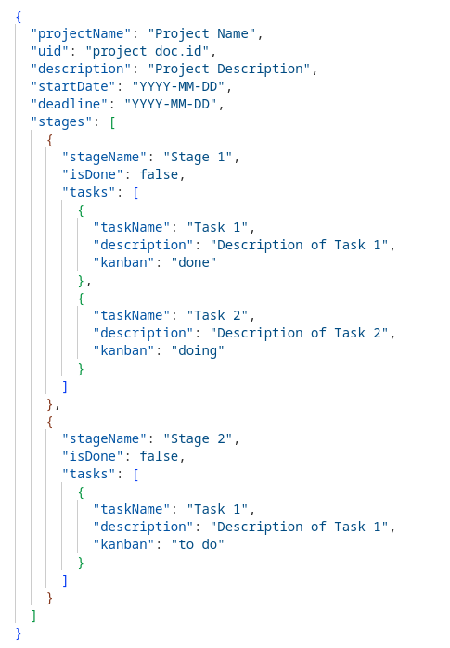
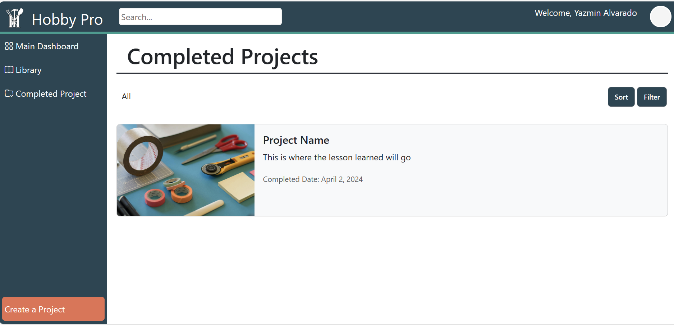
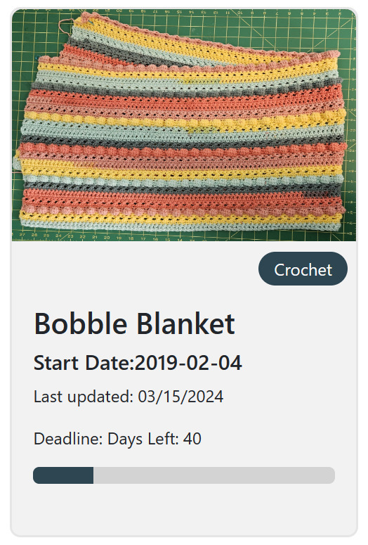
HobbyPro
Candelario Aguilar Torres, Yazmin Alvarado, Dustin Bailey, Samuel Fletcher
Dept. Of Computer Science and Information Technology
Abstract
Design
HobbyPro is a web-based, mobile-friendly project management application created for individual hobbyists. Core features include an intuitive interface to manage multiple projects within one repository. Hobbyists can create projects and add as many “stages” to break down projects into manageable work. This allows hobbyists to tailor each project to their individual needs easily. To further promote the idea of tailoring each project, hobbyists can set deadlines within their projects and track the time spent. Within each stage, hobbyists can add tasks to a kanban board to help visualize work and maximize efficiency. Notes, documents, and images can be added as needed to the project or individually in a library to serve as inspiration for future projects. Utilizing visualization tools, Hobby Pro displays a progress bar for each project to identify how far along a project has been completed. Hobby Pro’s goal is to streamline tracking and project organization by providing a centralized space for users to manage all aspects of their hobbies efficiently.
We set out to develop HobbyPro as a flexible project management tool that can be used for any hobby. Thus, the design of HobbyPro underwent several iterations before ultimately adopting a dashboard view as it aligned with our initial requirements and provided the most comprehensive data visualization.
We wanted our project icon to be a straightforward card layout containing essential project information such as the project’s name, start date, last update date, and deadline (and if included the number of days left). Additionally, a progress bar was included in the project icon to help users visualize project progress. As for the “stages”, we wanted what we considered the top three essential features, to add tasks, notes, and images in a simple easy-to-use layout. The best approach in our eyes was to add a kanban board for organizing tasks, and a text area for notes in each stage, while leaving images as an optional add-on. Once again, the dashboard view was instrumental in visualizing the work and progress of the overall project. The dashboard view also gave us the opportunity in terms of space to add buttons for adding time spent working on the project as well as changing the settings of the project. As for other aspects of the project, the design of it began to make sense as we worked on the design requirements of HobbyPro.
Figure 3: An example of the database schema showcasing data nesting
Figure 1: Sample Image of the Completed Project Page
Future Work
Background
The HobbyPro team hopes to enhance our website by implementing a community support feature that enables users to share and view other user projects. This will provide users with inspiration for their next big project, as well as the ability to rate and download projects from the community page. Additionally, we are looking to create a space for users to follow and message each other, fostering communication and collaboration within the HobbyPro community.
One of our team members faced a problem managing multiple projects from three different hobbies. After researching online and browsing through various forums, we realized that there is no real solution available on the market for hobbyists to organize their tasks. Most of them just settle for using notebooks or Excel spreadsheets. Some even end up using multiple software to keep track of their time and tasks. To address this issue, we decided to create an easy-to-use platform that combines all these needs in one place. This is how the idea of HobbyPro came into existence.
Technology
References
We used the following technologies for our project:
HyperText MarkUp Language (HTML): The standard mark-up language used to define the structure of a webpage.
Cascading Style Sheets (CSS): The standard language used the describe the presentation of elements within a webpage. This can include color, font, size, position, and various other effects.
Vue.js: A JavaScript framework that offers a component-based programming model which allows developers to build complex user interfaces.
Bootstrap: A CSS library used to create responsive mobile-friendly web applications.
Firebase Authentication: A Firebase module that provides authentication and authorization services that integrate with various systems. Firebase authentication leverages industry standards such as Oauth2.0 and OpenID Connect.
Firebase FireStore: A scalable, NoSQL databased designed to integrate with mobile, web, and server platforms.
Firebase Cloud Storage: An object storage service used to store user generated content such as photos, images., videos and PDF's.
W3Schools https://www.w3schools.com/
Vue.js https://vuejs.org/
Bootstap https://getbootstrap.com/
Firebase https://firebase.google.com/
Acknowledgements
We would like to thank Dr. Karen Meisch for her support of students in the College of Science, Technology, Engineering & Mathematics, and Dr. Leong Lee for his support of students in the Department of Computer Science and Information Technology, and Dr. Nicholson for his support of students.
Figure 2: Project Icon that appears on the Main Dashboard

